Slide 1
YEAR 11 ATAR HUMAN BIOLOGY UNIT 1 – THE FUNCTIONING HUMAN BODY
CHAPTER 1 – HUMAN BIOLOGICAL SCIENCE
CHAPTER 2 – SCIENTIFIC INQUIRY

Slide 2

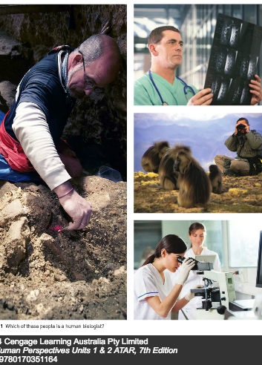
WHAT IS HUMAN BIOLOGY?
Human biological science is the scientific study of humans, both as individuals and as populations, and the study of the interactions between humans and their environment.

Slide 3
What is science?
Science is a process of inquiry – a way of finding out about human beings and their living and non-living surroundings.
Science is a body of knowledge – gained by systematic observation and testing of ideas

Slide 4


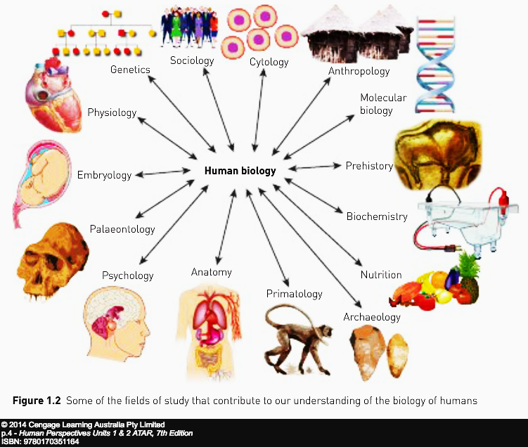
Human biological science
Information about humans is gained by scientific investigation.
Knowledge about humans is built on discoveries made by generations of scientists.
Human biological science sources its knowledge from the information gained through many different types of science.

Slide 5
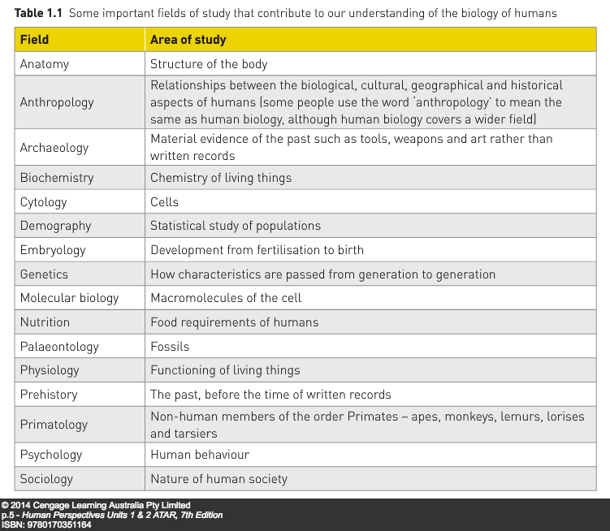

Slide 6
How do scientists investigate? The scientist defines a problem and then tries to find a solution to that problem
Literature review – search for a solution to the problem
Observation – information gained by using the senses
Classifying – placing things into groups based on the similarity of their characteristics
Experimentation
Propose a hypothesis that can be tested to find data that support or disprove the hypothesis
Test only one variable at a time
For data to be valid, the experiment must be controlled by running a separate experiment in which the only difference is the variable being tested.
Factors that may provide variations in the data need to be eliminated – these are called controlled variables

Slide 7
How do scientists avoid bias and error?
OBJECTIVITY – not allowing personal thoughts and feelings to influence the recording or interpretation of observations.
Recording actual measurements of observations (quantitative data) rather than personal judgements of the degree of change being observed (qualitative data).
If qualitative data are used, a reference chart that prescribes how the judgements were made can be used.
VALIDITY AND RELIABILITY OF RESULTS
Validity – the experiment is testing what it is supposed to test; all variables are controlled
Reliability – the experiment gives the same result each time it is performed – measuring instruments are calibrated and accurate – repetition confirms if the experiment is reliable
Peer review – results are published so that other scientists can examine the results to see if they agree with the way in which it was conducted

Slide 8
Making Sense of data
Data - Observations and measurements collected during a scientific investigation – often displayed in
Tables – organised lists of data, particularly useful for displaying numerical data.
Graphs - make it easy to see trends and make predictions (see Chapter 2)
Numerical data – use of averages or means allows for comparisons (Add up all the data values and divide by the number of measurements); eliminates the outliers, the extreme measurements that are well beyond the range of the other measurements that will affect means.
Ratios and rates
Ratios - numerical statement of how one value relates to another – for example Surface Area to Volume Ratio – the surface area of an object relative to its volume
Rate – the measurement of a value per unit of time – for example heart rate is measured in beats per minute
Percentages – means per hundred
Percentage change – allows a comparison between then and now to quantify by how much something has changed
Frequencies – the number of times an event occurs – often displayed on a frequency distribution or dot-frequency graphs or histograms

Slide 9
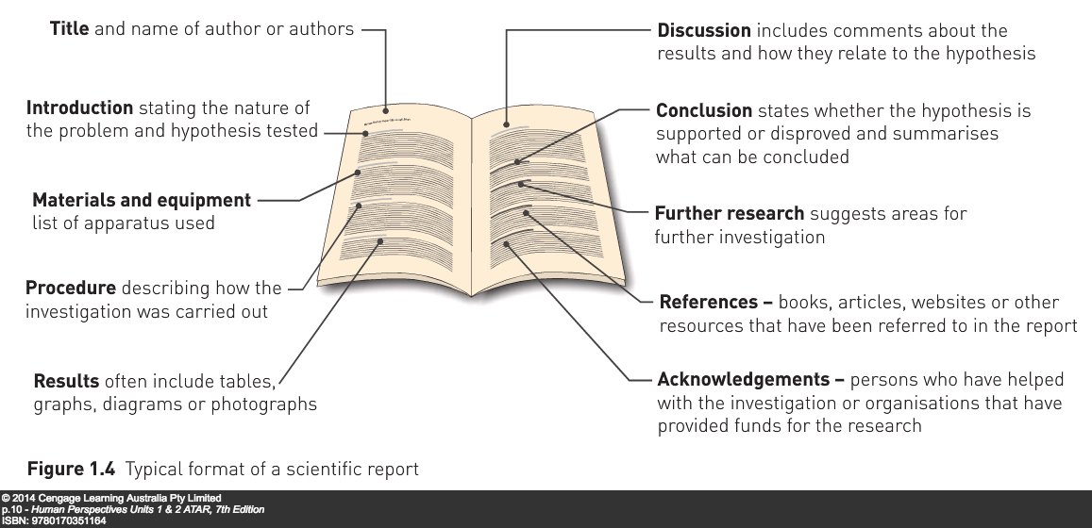
How do scientists report their findings?
REPORTS – particular writing style – impersonal presentation (“third person”) with no pronouns or names of participants – and in past tense
CONFERENCES – scientists present their findings (papers) at gatherings of scientists
PEER REVIEW – papers are published in journals where the information is exposed to experts in the field of study

Slide 10
chapter 2 scientific inquiry

Slide 11
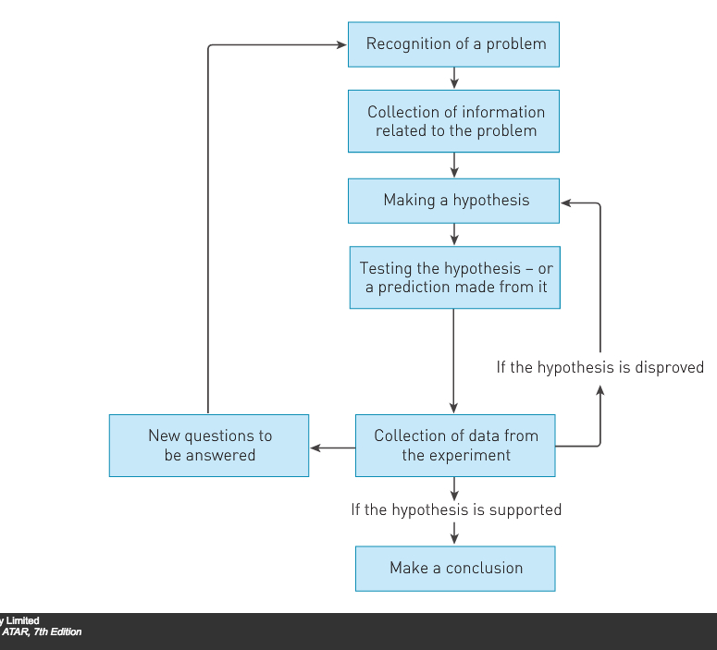
Scientific method
A systematic pattern or sequence of steps that is followed to discover the solution to a problem.
Precise method is unique to the circumstances, but underlying pattern is similar in all cases.

Slide 12
Scientific method
Recognition and definition of the problem – an observation raises curiosity that demands investigation. This results in the formulation of a question – Pasteur: “What allows microbes to cause fermentation and disease?”
Gathering information enabled him to formulate a hypothesis: Microbes in the air cause fermentation in broth.
The next step is to test the hypothesis, or a prediction made from the hypothesis, by using a suitable experiment.
As the experiment proceeds, the scientist records measurements that form the data of the investigation.
After all the data are recorded, the scientist makes an interpretation of the data, deciding whether the data support or disprove the hypothesis.
Once the scientist has made this decision, they can publish their conclusions to communicate them to others.
PLEASE NOTE: The results of an experiment cannot prove a hypothesis; a hypothesis can only be supported or disproved.

Slide 13
HYPOTHESES
A tentative proposal made to explain certain observations. This requires investigation to collect evidence that will support it.
A good hypothesis:
Is a definite statement – not a question: “Microbes in the air cause fermentation in broth.”
Is concise
Refers to a single testable idea
Links the dependent and independent variables: “Microbes in the air (independent variable)…cause fermentation in broth (dependent variable)

Slide 14
Hypotheses (cont’d)
CASE IN POINT: Does an increase in exercise cause heart rate to increase?
3 valid hypotheses are possible for most questions raised for investigation:
An increase in exercise causes an increase in heart rate.
An increase in exercise causes a decrease in heart rate.
An increase in exercise has no effect upon heart rate.
Each of these is a testable statement.

Slide 15
Designing experiments
Experiments must be designed so that the results will clearly support or disprove the hypothesis.
To do this:
Only one factor, or variable, is tested at a time.
A control, or comparison, experiment is conducted in which the only difference is the influence of the variable being tested. For example, in “An increase in exercise causes an increase in heart rate”, the control experiment would involve checking the heart rate of subjects who do not increase their exercise.
Such an experiment involving an experimental group and an appropriate control group is known as a fair test.
Where applicable, it involves the use of instruments that provide distinct measurements. Measurements are precise and easier to compare than descriptions of observations

Slide 16
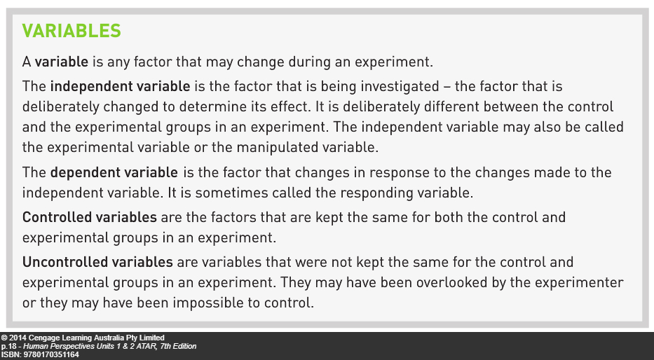

Slide 17
Designing experiments (cont’d)
Scientific experiments always involve repetition. This may mean:
Doing the same experiment many times, or
Performing the same experiment on a large number of subjects at the same time.
Having a large sample size is particularly important for the reliability of investigations involving humans. This large sample size helps to eliminate the variations that can be introduced by outliers. Sample sizes for investigations involving humans often run into the tens of thousands of subjects for this reason.

Slide 18
Designing experiments: experimental error
Results of experiments always contain errors.
To account for this, scientists will often state “It is likely that…” or “It is probable that…”
Three possible types of errors:
Human errors – mistakes in the collecting of data or recording of data. These are not included as experimental error.
Random errors – small errors in the taking of measurements that provide variations in the data; for example the small variations that will occur in using a stopwatch; these are not human errors but limitations in the data collection procedure
Systematic errors – occur because of the way in which an experiment is designed so measurements will always be too high or too low – requires the changing of the experimental procedure.
To eliminate sources of error, the experiment must be designed critically and carefully.
Reporting requires acknowledgement of the possible sources of error.

Slide 19
Investigating humans
ETHICAL CONSIDERATIONS
Ethics: a set of moral values and principles
Ethical behaviour: behaviour that conforms to moral values and principles
Scientific research, particularly involving human participants, often involves ethical issues. Ethics committees in Australian universities ensure that scientific research is undertaken through ethical standards. Australian schools and universities are also monitored regarding the ethical use and confinement of animals during their research.
Ethical principles that must be satisfied during an investigation include:
Voluntary participation – people participate by their own free will.
Informed consent – participants informed about the objectives of the research, procedures, risks and benefits. Written consent is obtained after all information is given
Risk of harm – some procedures may involve harm but this needs to be minimized and relationship between risk and benefits carefully assessed
Confidentiality - identities of participants must not be revealed even if known to the researcher
Anonymity – identities of participants are concealed even from the researchers

Slide 20
PLACEBOS:
Used in research into new medications
An inactive substance that looks the same as the real medication
The experimental group are given the real medication and the control group are given the placebo.
Subjects don’t know whether they are given the real medication or the placebo.
Doesn’t have to be a tablet; can be any “dummy” treatment such as an injection, skin patch, nasal spray, special diet, physical therapy, mock surgery.
Patients given placebos often show improvement; called the placebo effect.
Placebo experiments are often blind experiments where the subject does not know whether they are given the real medication or the placebo; double-blind experiments occur when neither the researcher or the subjects know who has been given the real medication or the placebo.
Reduces the risk of bias

Slide 21
Presentation of data
TABLES
Organized and concise ways of presenting data
Rules for tables
Table must have a title stating the independent and dependent variables – “Table showing heart rate with increasing exercise time”.
Data are presented in columns
Each column has a heading that names the variable and the units in which it is measured

Slide 22
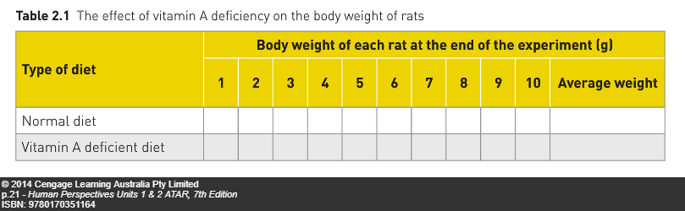

Slide 23
Presentation of data cont’d
GRAPHS: Useful ways of presenting data
Independent variable normally plotted on the horizontal axis; dependent variable normally plotted on the vertical axis
Label the axes with names of the variables
Indicate the units in which the variable is measured
Give the graph a title that summarizes the relationship between the variables – “Graph of heart rate with increasing exercise time”
Use equal intervals of units on each axis
Appropriate size – use most of the graph sheet
Appropriate type
Line graph – when data are even and continuous; in human biology, ruled lines join points.
Bar or column graph – when data are discreet or in groups e.g. comparisons between different types; contain spaces between columns
Histograms – used to show frequencies – how often a particular value or characteristic occurs. Population pyramids are histograms.

Slide 24
